Slide 1
SOFTWARE TESTING STRATEGIES

Slide 2
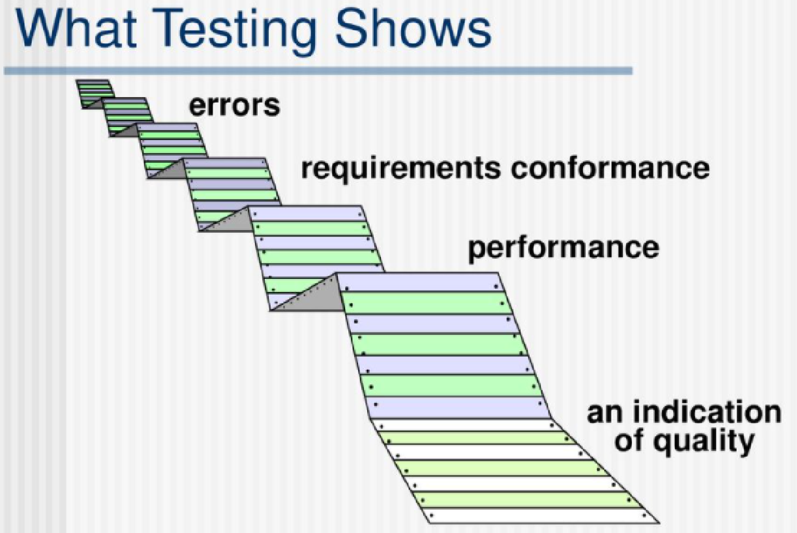
Software Testing
Testing is the process of exercising a program with the specific intent of finding errors prior to delivery to the end user.

Slide 3
Strategic Approach To Testing
conduct effective technical reviews ->many errors will be eliminated before testing commences.
Begin testing at the component level and works "outward" toward the integration of the entire computer- based system.
Different testing techniques are appropriate for different software engineering approaches and at different points in time.
Testing is conducted by the developer of the software or an independent test group.
Testing and debugging are different activities, but debugging must be accommodated in any testing strategy.

Slide 4
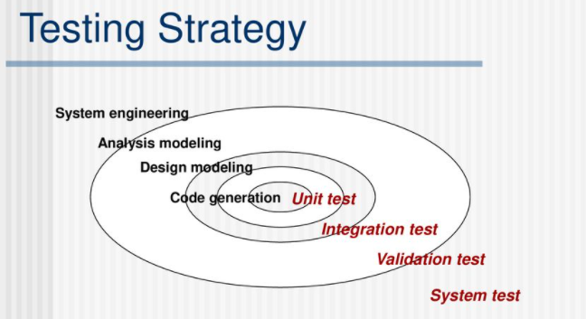
For conventional software
The module (component) is our initial focus & Integration of modules follows
For OO software
our focus changes from an individual module (the conventional view) to an OO class that encompasses attributes and operations and implies communication and collaboration

Slide 5
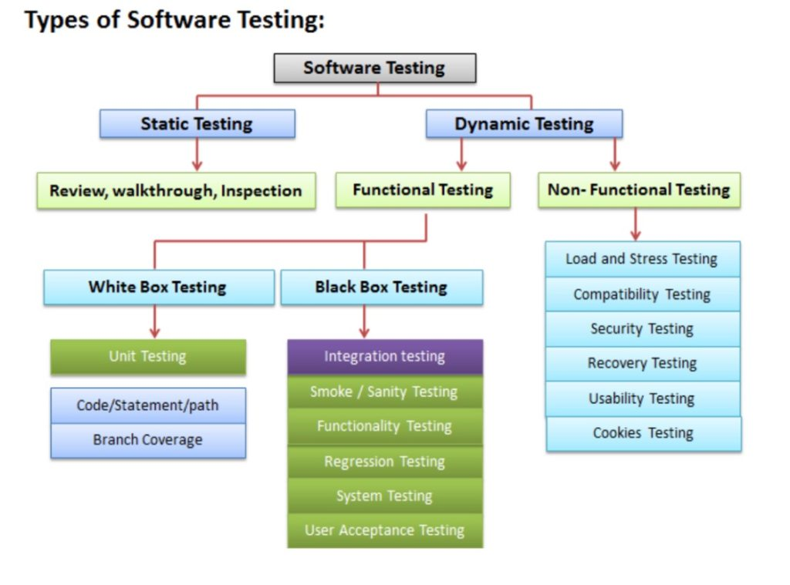

Slide 6
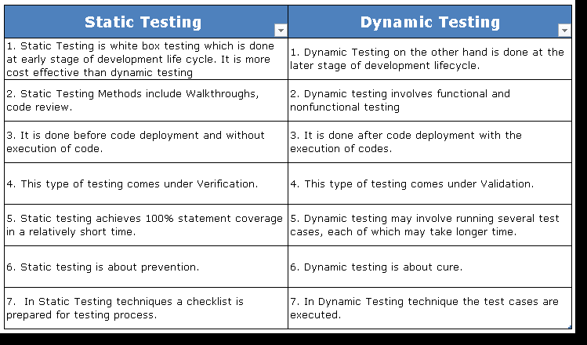

Slide 7
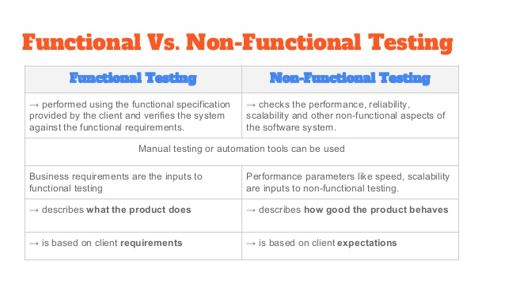

Slide 8
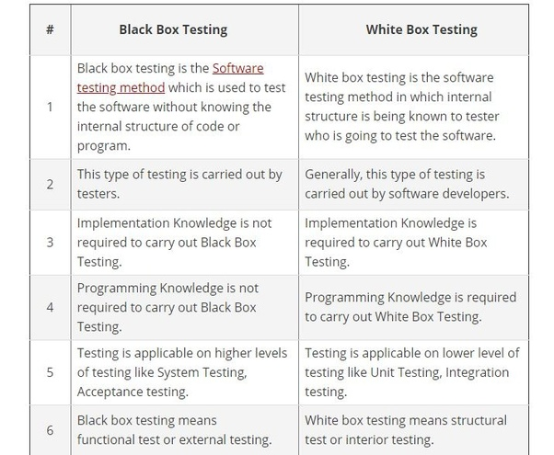

Slide 9

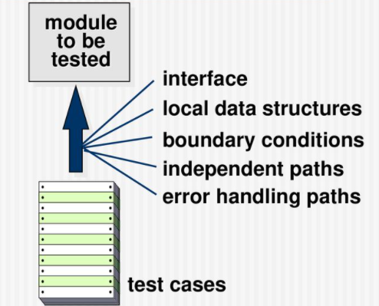

Slide 10
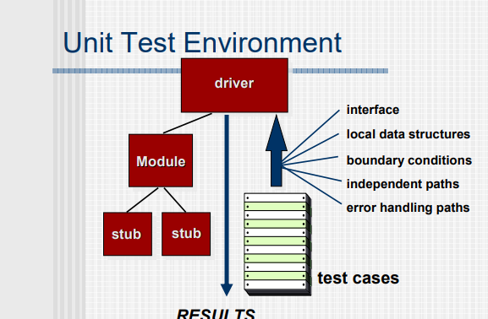

Slide 11



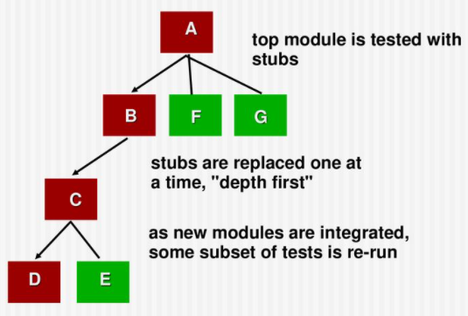
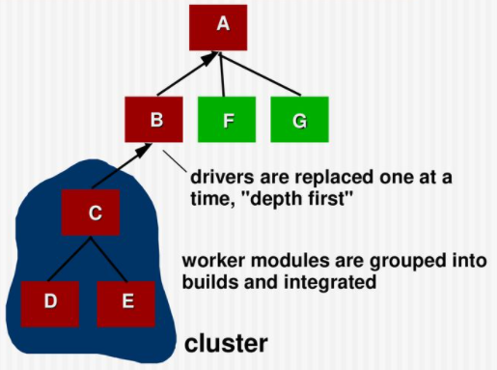
software modules are integrated logically and tested as a group.
expose defects in the interaction between these software modules when they are integrated
Methods
Big-bang Methodology
Incremental Model

Slide 12
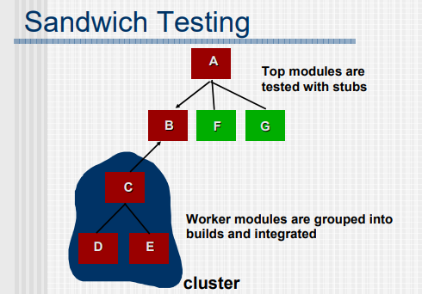

Slide 13
Regression Testing
Whenever software is corrected, some aspect of the software configuration (the program, its documentation, or the data that support it) is changed.
Re-execution of a subset of tests to ensure that changes have not propagated unintended side effects
Helps to ensure that changes do not introduce unintended behavior or additional errors
May be conducted manually, by re-executing a subset of all test cases or using automated capture/playback tools.

Slide 14
Smoke Testing
Smoke testing steps: Software components that have been translated into code are integrated into a “build.”
A build includes all data files, libraries, reusable modules, and engineered components that are required to implement one or more product functions.
A series of tests is designed to expose errors that will keep the build from properly performing its function.
The intent should be to uncover “show-stopper” errors that have the highest likelihood of throwing the software project behind schedule.
The build is integrated with other builds and the entire product (in its current form) is smoke tested daily.
The integration approach may be top down or bottom up.

Slide 15
Object-Oriented Testing
begins by evaluating the correctness and consistency of the analysis and design models
testing strategy changes
the concept of the ‘unit’ broadens due to encapsulation
integration focuses on classes and their execution across a ‘thread’ or in the context of a usage scenario
validation uses conventional black box methods
test case design draws on conventional methods, but also encompasses special features

Slide 16
OO Testing Strategy
Class testing is the equivalent of unit testing
operations within the class are tested
the state behavior of the class is examined
integration applied three different testing
Thread-based testing - integrates the set of classes required to respond to one input or event
Use-based testing—integrates the set of classes required to respond to one use case
Cluster testing—integrates the set of classes required to demonstrate one collaboration

Slide 17
WebApp Testing
The content model for the WebApp is reviewed to uncover errors.
The interface model is reviewed to ensure that all use cases can be accommodated.
The design model for the WebApp is reviewed to uncover navigation errors.
The user interface is tested to uncover errors in presentation and/or navigation mechanics.
Each functional component is unit tested.

Slide 18
WebApp Testing
Navigation throughout the architecture is tested.
The WebApp is implemented in a variety of different environmental configurations and is tested for compatibility with each configuration.
Security tests are conducted in an attempt to exploit vulnerabilities in the WebApp or within its environment.
Performance tests are conducted.
The WebApp is tested by a controlled and monitored population of end-users.
The results of their interaction with the system are evaluated for content and navigation errors, usability concerns, compatibility concerns, and WebApp reliability and performance.

Slide 19
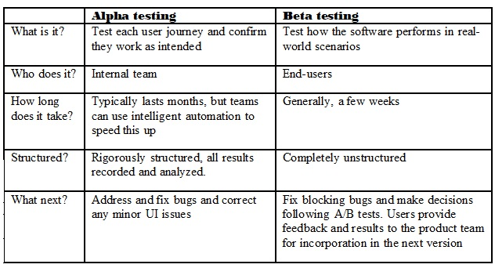
Validation Testing
The process of evaluating software during the development process or at the end of the development process to determine whether it satisfies specified business requirements.
Validation Testing ensures that the product actually meets the client's needs.

Slide 20
System testing
System testing is testing conducted on a complete integrated system
to evaluate the system's compliance with its specified requirements.
System testing takes all of the integrated components that have passed integration testing as input
Recovery testing
forces the software to fail in a variety of ways and verifies that recovery is properly performed
Security testing
verifies that protection mechanisms built into a system will, in fact, protect it from improper penetration
Stress testing
executes a system in a manner that demands resources in abnormal quantity, frequency, or volume
Performance Testing
test the run-time performance of software within the context of an integrated system
DEPLOYMENT TESTING (CONFIGURATION TESTING)
exercises the software in each environment in which it is to operate

Slide 21
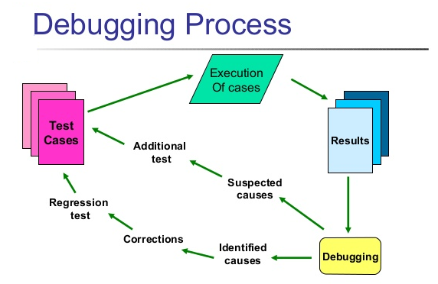

Slide 22

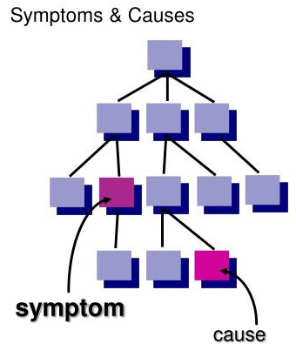
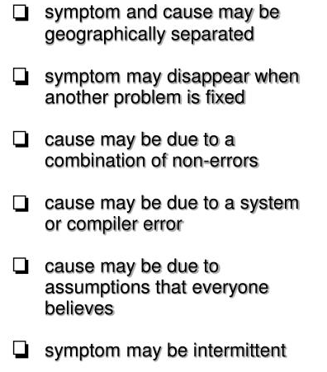

Slide 23
Bug Categories
function-related bugs
system-related bugs
data bugs
coding bugs
design bugs
documentation bugs
Standards violations
Debugging Techniques
brute force / testing
Backtracking
Cause Elimination
1. Induction
2. Deduction
Automated Debugging
The people factor
Correcting the Errors
Is the cause of the bug reproduced in another part of the program?
What "next bug" might be introduced by the fix I'm about to make?
What could we have done to prevent this bug in the first place?

